Slide 1
Franchise Management System

Slide 2
ABSTRACT
PRIME COMPUTER SERVICES consists of list of records about the management of the details of the students , faculty and courses.
This is a web-based application.
The project has five modules namely-
Login component,
Administrator Component,
Franchise Manager Component,
Student Component.
Faculty Component

Slide 3
System Specifications
Hardware Requirements:
Storage: Minimum 1.5GB Storage.
Ram: 4GB.
Hard disk: 10 GB
Processor: Intel i3/i5
Software Requirement:
Language: Laravel Framework
For Design: HTML , CSS , PHP , and Java Script
Database: XAMPP SQL Server
Platform: VS Studio
Operating System: Windows, Linux

Slide 4
Proposed System
The Franchisee Management System is a software application which avoids more manual hours that need to spend in record keeping and generating reports. Maintaining of franchise details is complex in manual system in terms of agreements, royalty and activities.
Existing System
An educational institute which is having several franchises throughout the city finds it difficult to communicate between one another and with the head office. It results in delay of taking decisions regarding meetings, issuing of material, payment of fee, etc.

Slide 5
DFD Diagram
A data flow diagram (DFD) is a graphical representation of the "flow“ of data through an information system. It differs from the system flowchart as it shows the flow of data through processes instead of hardware.

Slide 6
FACULTY MANAGEMENT
LOGIN MANAGEMENT
AGREEMENT DETAILS
FRANCHISE
MANAGEMENT
SYSTEM
STUDENT MANAGEMENT
BATCH MANAGEMENT
FRANCHISE MANAGEMENT
COURSE MANAGEMENT
DFD LEVEL 0

Slide 7
FACULTY MANAGEMENT
FACULTY DETAILS
LOGIN MANAGEMENT
LOGIN DETAILS
STUDENT MANAGEMENT
STUDENT DETAILS
FRANCHISE
MANAGEMENT
SYSTEM
FRANCHISE MANAGEMENT
FRANCHISE DETAILS
COURSE MANAGEMENT
COURSE DETAILS
AGREEMENT MANAGEMENT
AGREEMENT DETAILS
BATCH MANAGEMENT
BATCH DETAILS
DFD LEVEL 1

Slide 8
LOGIN TO SYSTEM
CHECK ROLE TO ACCESS
ADMIN
MANAGE FACULTY DETAILS
CHECK DETAILS
MANAGE LOGIN CREDENTIALS
MANAGE STUDENT DETAILS
MANAGE MODULES
MANAGE FRANCHISE DETAILS
MANAGE COURSE DETAILS
MANAGE AGREEMENT DETAILS
MANAGE SYSTEM
MANAGE ROLE OF USERS
MANAGE BATCH DETAILS
DFD LEVEL 2

Slide 9
DFD LEVEL 2
ADMIN
Add and modify details
FRANCHISE MANAGEMENT SYSTEM
Provides Courses
Issues Certificate
Provide Student Reports
Registering Courses
Add and modify details
FRANCHISE
STUDENT
Attending Classes

Slide 10
E-R diagram
E-R diagram is entity relationship diagram which can describes interrelated things of interest in a specific domain of knowledge.
An Entity Relationship (ER) Diagram is a type of flowchart that illustrates how “entities” such as people, objects or concepts relate to each other within a system.

Slide 11
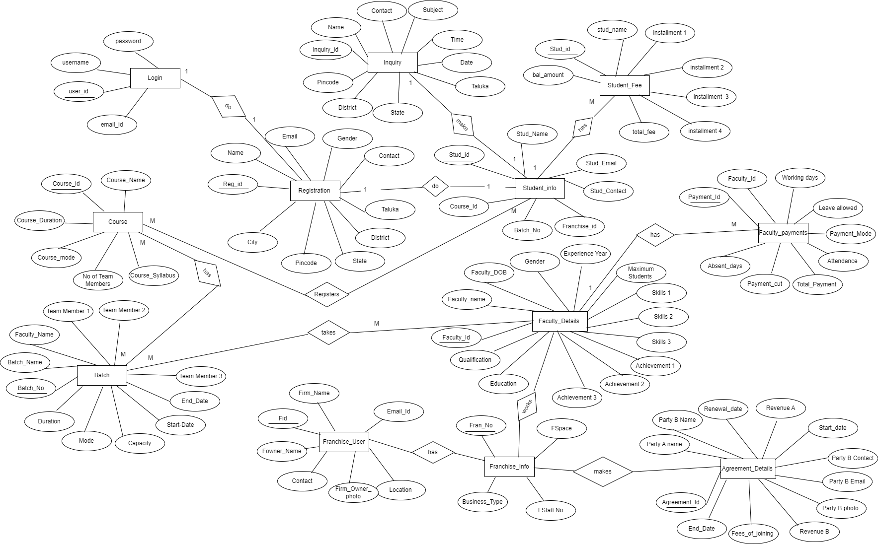

Slide 12
LOG IN TABLE
ID | USERNAME | PASSWORD | EMAIL ID
101 | Sachin | Admin@123 | sachin@gmail.com
102 | Manish | Manish@123 | manish@gmail.com
REGISTRATION TABLE
ID | NAME | CONTACT | EMAIL | GENDER | STATE | CITY | DISTRICT | TALUKA | PIN CODE
1 | Jay | 932280*** | jay@gmail.com | MALE | MH | PUNE | PUNE | HAVELI | 411046

Slide 13
INQUIRY TABLE
 | NAME | CONTACT | EMAIL | STATE | CITY | DISTRICT | TALUKA | PIN CODE | INQUIRY SUBJECT
 | Jay | 932280*** | jay@gmail.com | MH | PUNE | PUNE | HAVELI | 411046 | For Franchise
 |  |  |  |  |  |  |  |  | For course
COURSE TABLE
COURSE ID | COURSE NAME | COURSE DURATION | COURSE MEMBER | COURSE SYLLABUS | COURSE MODE
101 | DIGITAL MARKETING | 3 MONTH | 4 MEMBER | PDF UPLOAD | OFFLINE

Slide 14
BATCH TABLE
BATCH NO | BATCH NAME | STARTING DATE | ENDING DATE | FACULTY NAME | DURATION | MODE | CAPACITY
101 | JAVA | 1\01\2024 | 1/4/2024 | MR. XYZ | 3 MONTH | OFFLINE | 30
STUDENT FEE
STUDENT NO | STUDENT NAME | TOTAL FEE | 1ST INSTALLMENT | 2ND INSTALLMENT | 3RD INSTALLMENT | BALANCE AMOUNT
STUDENT INFO
ID | NAME | EMAIL | CONTACT | GENDER | COURSE ID | BATCH NO | FRANCHISEID

Slide 15
AGREEMENT DETAILS TABLE
AGR. ID | PARTY A | PARTY B | AGREEMENT COPY PDF | START DATE | END DATE | FEE OF JOINING | REVENUE TO % A | REVENUE TO % B
501 | LTOR | XYZ | DOCUMENT.PDF | 12/12/2023 | 19/09/2024 | 7000 | 30% | 70%
RENEWAL DATE | PARTY B NAME | PARTY B CONTACT | PARTY B EMAIL | PARTY B PHOTO
20/09/2024 | XYZ | 9451532588 | XYZ@GMAIL.COM

Slide 16
FACULTY DETAILS
ID | NAME | GENDER | CONTACT NO | DOB | EXPERIENCE YEAR | SKILLS 1 | SKILLS 2 | SKILLS 3
101 | XYZ | FEMALE | 9421058865 | 04/12/2004 | 2 YEARS | JAVA | PYTHON | HTML
ACHIEVEMENT 1 | ACHIEVEMENT 2 | ACHIEVEMENT 3 | MAXIMUM STUDENT | EDUCATION | QUALIFICATION
 |  |  | 20 | BE
FACULTY PAYMENTS
FACULTY ID | PAYMENT ID | WORKING DAYS | LEAVE ALLOWED | ABSENT DAY | PAYMEMNT CUTTED | ATTENDANCE | TOTAL PAYMENT
101 | 10 | 22 | 15 | 4 | 0 | 85%

Slide 17
FRANCHISE TABLE
FID | FOWNER NAME | FRIMNAME | FIRM OWNER PHOTO | FCONTACT NUMBER | FEMAIL | FLOCATION | FTALUKA | F DISTRICT
101 | XYZ |  | PHOTO | 9421356684 | XYZ@GMAIL.COM | KATRAJ | HAVELI | PUNE
FRANCHISE INFO DETAILS
FID | FNO | FSPACE IN SQRFT | FSTAFF NO | FBUSINESS TYPE
101 | 111 | 602 | 20 | ACADEMY

Slide 18
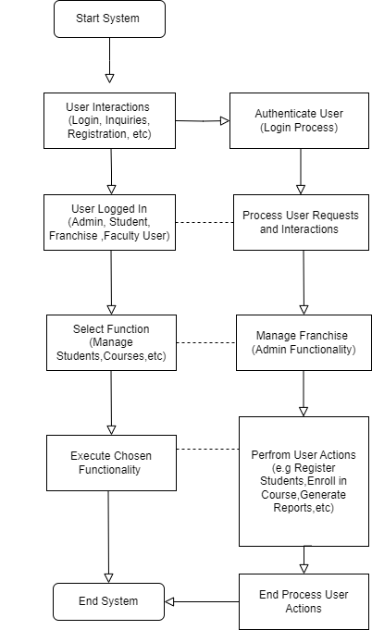
System flowchart
A flowchart is a visual representation of a system or process using symbols and connectors to illustrate the sequence of steps or actions involved. It helps depict the flow of information, data, or activities within a system.

Slide 19
UML Diagrams
Usecase Diagram:
A use case diagram is a graphical depiction of a user's possible interactions with a system. A use case diagram shows various use cases and different types of users the system has and will often be accompanied by other types of diagrams as well. The use cases are represented by either circles or ellipses.

Slide 20
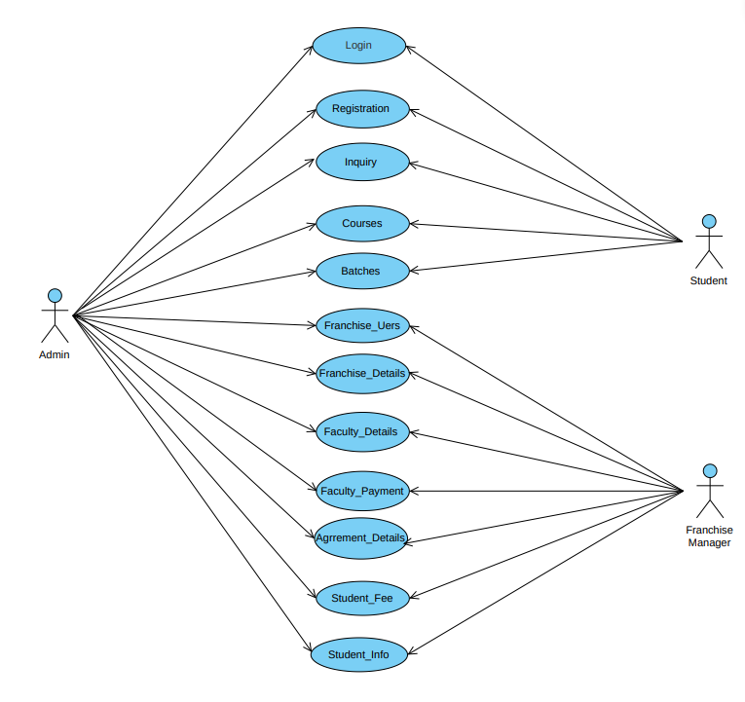

Slide 21
SEQUENCE DIAGRAM:
An Sequence diagram shows an interaction, consisting of set of objects and their relationship including the messages that may be dispatched among them.

Slide 22
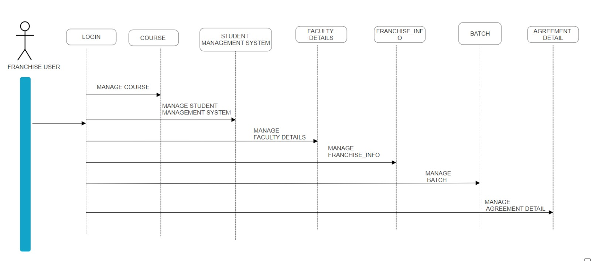

Slide 23
Class Diagram
The class diagram depicts a static view of an application. It represents the types of objects residing in the system and the relationships between them.
A class consists of its objects, and also it may inherit from other classes. A class diagram is used to visualize, describe, document various different aspects of the system, and also construct executable software code.

Slide 24
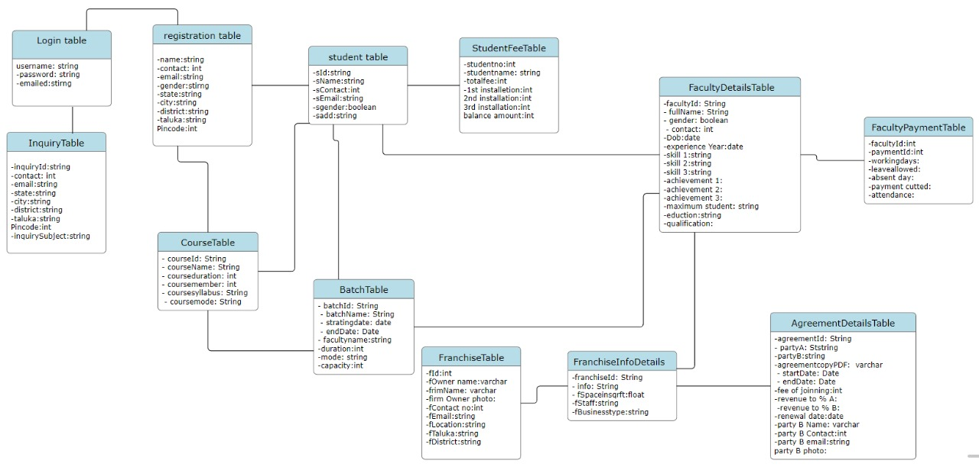

Slide 25
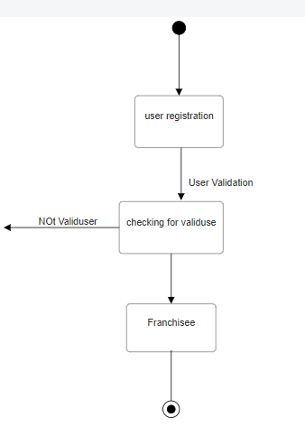
State Diagram
State diagram describes the flow of control from one state to another state. States are defined as a condition in which an object exists and it changes when some event is triggered.
The most important purpose of State diagram is to model lifetime of an object from creation to termination.

Slide 26
Object Diagram
Object diagrams are derived from class diagrams so object diagrams are dependent upon class diagrams.
Object diagrams represent an instance of a class diagram. The basic concepts are similar for class diagrams and object diagrams. Object diagrams also represent the static view of a system but this static view is a snapshot of the system at a particular moment.

Slide 27
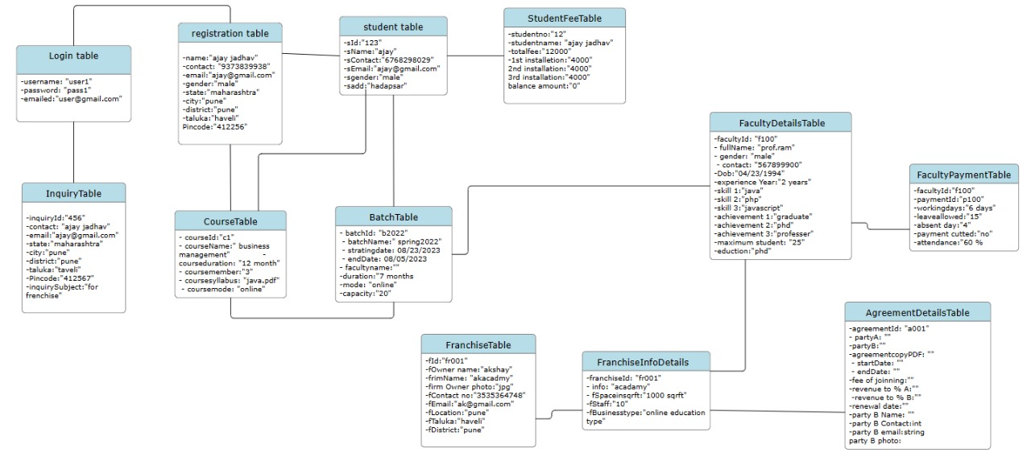

Slide 28
Activity Diagram
An activity diagram is a type of Unified Modeling Language (UML) flowchart that shows the flow from one activity to another in a system or process.
It's used to describe the different dynamic aspects of a system and is referred to as a 'behavior diagram' because it describes what should happen in the modeled system.

Slide 29
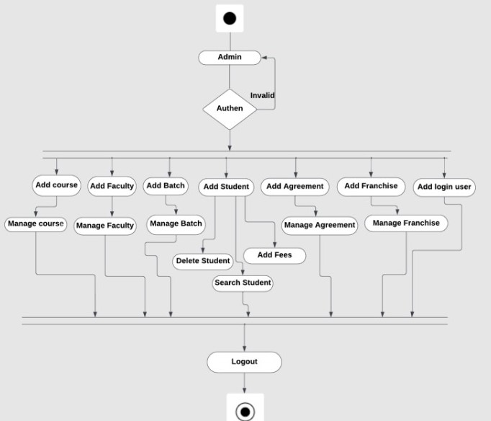

Slide 30
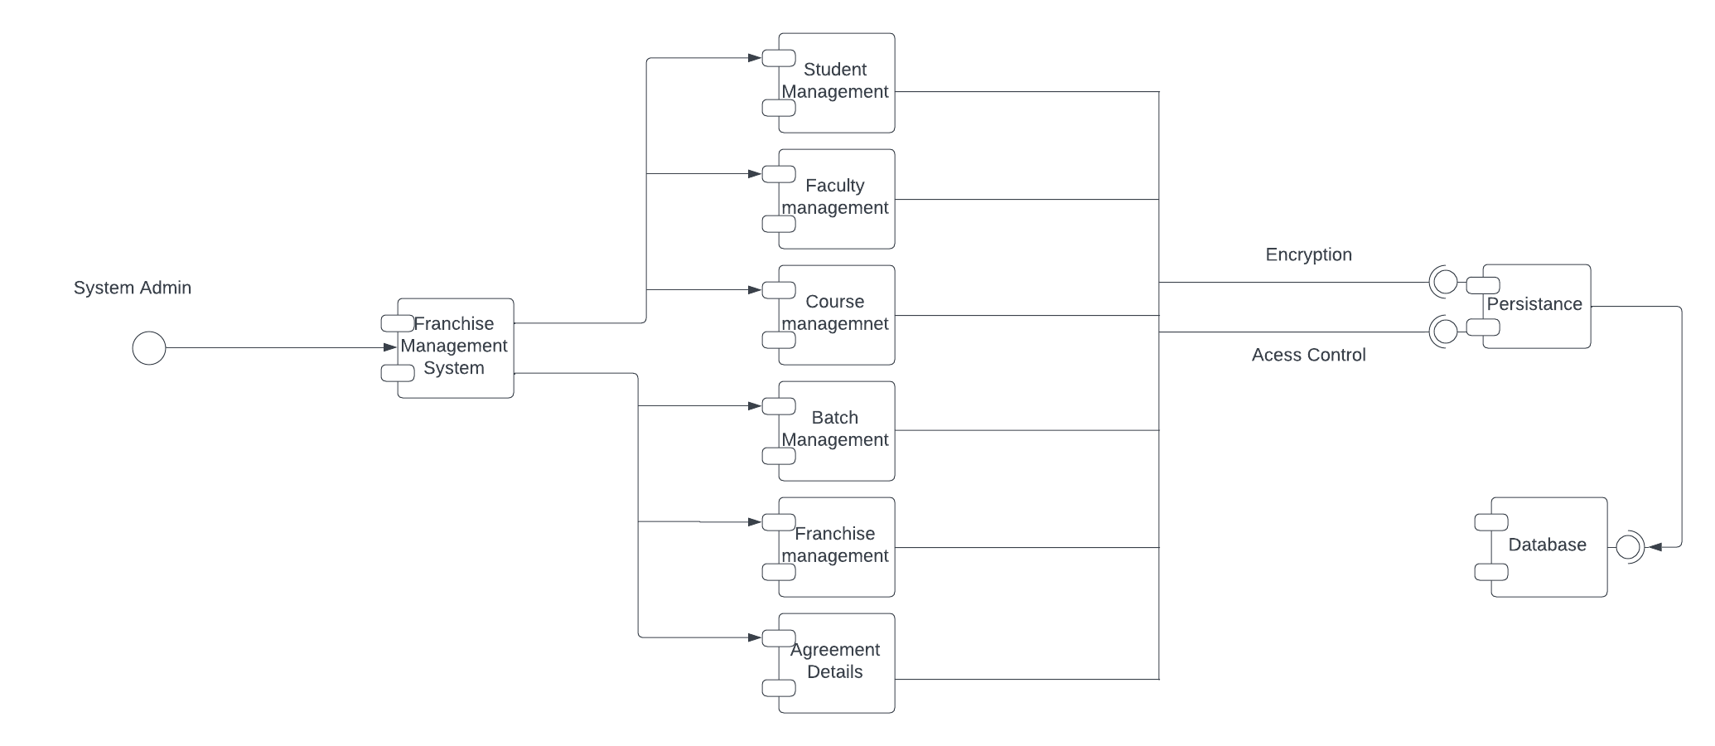
Component Diagram
A component diagram describes the organization and wiring of the physical components in a system. Component diagrams are often drawn to help model implementation details and double-check that every aspect of the system's required functions is covered by planned development.

Slide 31
Package Diagram
Package diagrams are structural diagrams used to show the organization and arrangement of various model elements in the form of packages. A package is a grouping of related UML elements, such as diagrams, documents, classes, or even other packages.

Slide 32
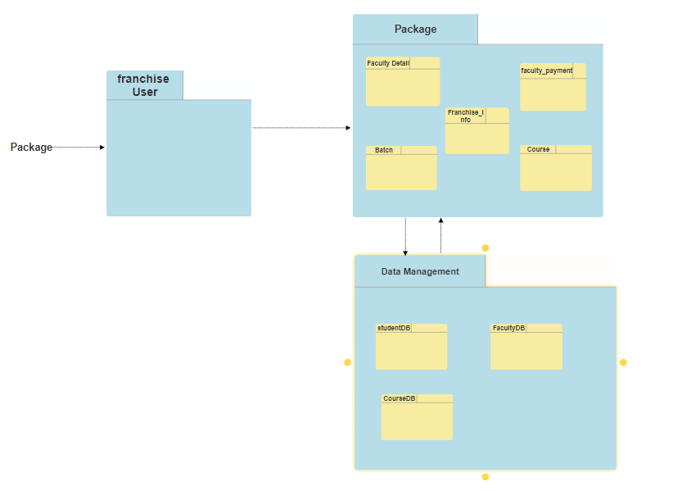

Slide 33
Deployment Diagram
A deployment diagram shows components and artifacts in relation to where they are used in the deployed system. A component diagram defines the composition of components and artifacts in the system.

Slide 34
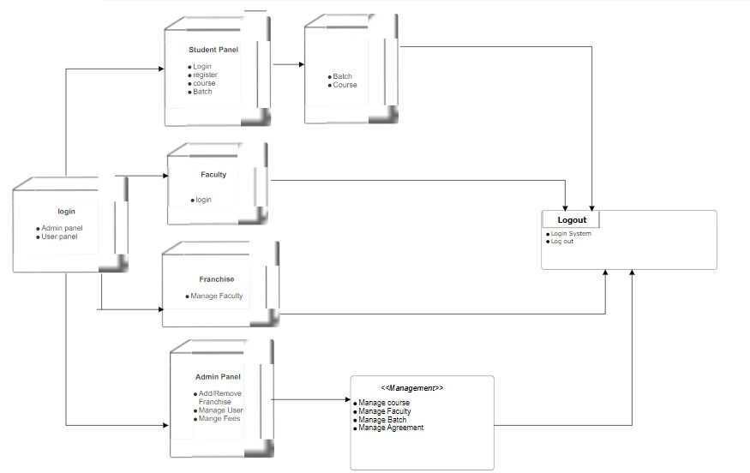

Slide 35
Future Enhancement
Exploring integration with emerging technologies such as virtual reality (VR) or augmented reality (AR) for enhanced learning experiences. Creating a mobile application to allow users to access the system on their smartphones or tablets, providing more flexibility and convenience. Enhancing communication features with smart notifications and alerts to keep students, faculty, and administrators informed about important updates and events.

Slide 36
Thank you !

